Slide 1
Emotion detection
CS616

Slide 2
Sources of affective responding
Personality
Emotion
Attitude
Temporal volatility

Slide 3

Emotions are universally recognized
But how?

Slide 4
Attention to the person or the emotion: Underlying activations in MEG
(Bayle, Bostan & Taylor, 2007)
Rationale
Facial emotion processing is fast (100ms) and automatic and occurs regardless of whether you attend to the face or not.
Facial identity is also fast (but slower) and occurs in parallel according to most models
But there is some evidence from schizophrenia suggesting that the parallel (and therefore separate) brain regions interact

Slide 5
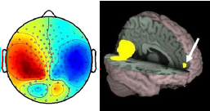
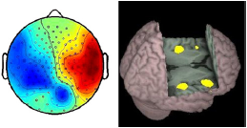
Methods and Results
Used MEG and happy/fear/neutral faces
Identity task - press button when 2 identities the same
Emotion task - press button when 2 emotions the same
90ms orbito-frontal response to emotion regardless of attention
170ms right insula response when attending to emotion
Conclusions
Parallel processing
verified
Also 220ms activation increase for areas associated with identity processing

Slide 6
Impaired facial emotion recognition and reduced amygdalar volume in schizophrenia
(Chihiro et al, 2007)
Rationale
Amygdala volume known to be reduced in Schizophrenics
Emotion recognition known to be impaired in Schizophrenia
Direct link between the two not studied (properly) before
Methods
Facial emotion intensity recognition task

Slide 7
Results
(1) The schizophrenia patients had smaller amygdalar volumes than the healthy controls;
(2) the patients showed impairment in recognizing facial emotions, specifically anger, surprise, disgust, and sadness;
(3) the left amygdala volume reduction in these patients was associated with impaired recognition of sadness in facial expressions.

Slide 8
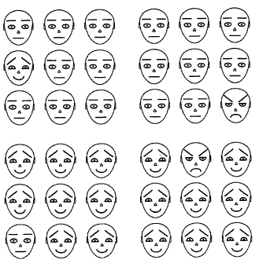


Automaticity of emotion recognition
Angry faces are detected much more rapidly than faces depicting non-threatening expressions
Attention is driven by fear
Ohman & Mineka, 2001

Slide 9
Summary
Emotion detection is built deep into the human information processing machinery
Very fast and sub-conscious detection of salient emotion cues

Slide 10
AI and emotion detection
How can a computer detect emotion in a human’s behavior?
Approaches
Motor expression
Facial detection
Speech-based detection
Physiological arousal
Galvanic skin response
Electromyelograms

Slide 11
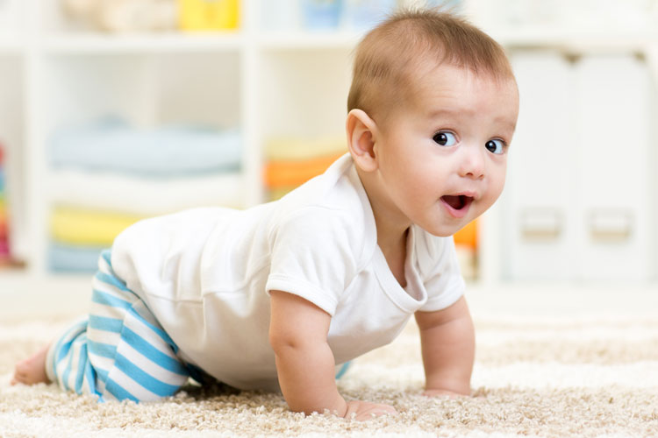
Facial Expression Recognition: supervised learning
Young children learn from parents’ facial expressions what is desirable and not

Slide 12
Facial expressions communicate
Babies (10 months) almost only smile in presence of caregiver
Babies look to caregiver and behave according to caregiver response when encountering novel object. E.g. a barking dog or a snake
This is known as social referencing and is also seen in chimpanzee societies
A similar process, observational fear, is seen in monkeys. Infant monkeys show fearful unconditioned response to mother’s expression of fear when the mother could see a snake, but the infants could not. That is, infants showed a fear response to the mother’s fear response.

Slide 13
9
Facial expressions allow for rapid communication
They are produced when there is an emotional stimulus and an audience present
Our interpretation of another’s emotion modulates our behaviour and vice versa
The ability to recognise emotion expressions appears very early
first few days (neonates) | can distinguish between expressions of happiness, sadness, and surprise
Four- to six-month | show preferences for facial expressions of happiness over neutral and angry expressions
seven months | can distinguish among expressions of fear, anger, surprise, happiness, and sadness

Slide 14
Classes of Expressions
Joy
Sadness
Fear
Disgust
Anger
Neutral

Slide 15
Automated Facial Expression Recognition
Affective computing depends on reliably detecting human emotion
Value proposition: natural ways of communication in person-to-machine interaction.
Supervised learning via facial expressions.
More natural (maybe) than keyboard or voice

Slide 16
General Machine Vision
First step in the process is “vision”.
After the image is acquired, some preprocessing is done such as to reduce noise, improve contrast.
Next features are extracted and areas of interest are “detected”
Finally some high-level processing occurs.

Slide 17
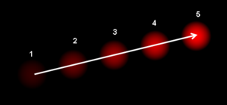
Optical Flow
Used to capture motion of objects due to relative motion between object and observer.
Also used to derive “structure” of objects.
Looks at intensity of “voxels” and tries to solve a set of differential equations.
Voxels = Volume Pixels = Think Pixels in 3d

Slide 18
Methods of Facial Reocognition
Early methods used optical flow to capture movement of features.(Such as facial muscles)‏
Modern methods are generally visual feature-based

Slide 19

Early emotion detection method
EMFACS (Ekman & Friesen,1973)
Coded muscular features involved in different emotive expressions
Tried to pick out the same features from videos
Manual annotation

Slide 20
Weighted Saliency Maps
Simple example of such a method. Uses pixel intensities of grayscale images.
Calculates ratio of variance between classes and within a class.
σk = VarB/VarW , k = 1,..., n.
VarB=Sum of (ClassMean - OverallMean)^{2,} for all classes and VarW=Sum of (f -MeanofClassof(f))^{2,} for all f. Here n is number of sample points.

Slide 21
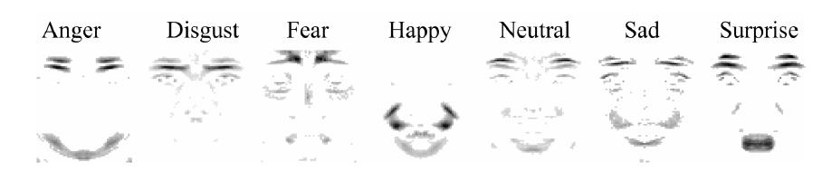
Weighted Saliency Maps‏
These ratios are then sorted in descending order .
Above is an example for the top 500 features of each class for a particular sample

Slide 22
Speech Tone Recognition
Why have humanoid robots ?
Enjoyable interaction
Doesn't require training
Easier to teach
Acoustic patterns contain :
Speaker identity
Speech content
Speech tone

Slide 23
Abstraction of the problem
Courtesy [7]
Classify a given sentence to convey one of:
Approval : Good!
Prohibition : No!
Attention bidding : This looks interesting
Soothing : It’ll be all right
Neutral : This is a book
Approach: use Prosodic Contours

Slide 24
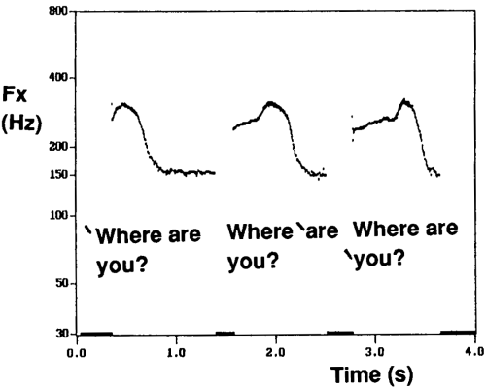
Using prosodic contours
Have to normalize for pitch, length, and a bunch of other parameters

Slide 25
Using prosodic contours
Intonation estimation
Glottal closure frequencies measured by laryngograph
Sampled at 1kHz
Can be approximated in practical applications
Power curve estimates
Windowed sampling
Normalized to mean value of neutral style per speaker
Voice activity estimation
Essentially just a noise filter
Trained to a threshold
ML to the rescue

Slide 26
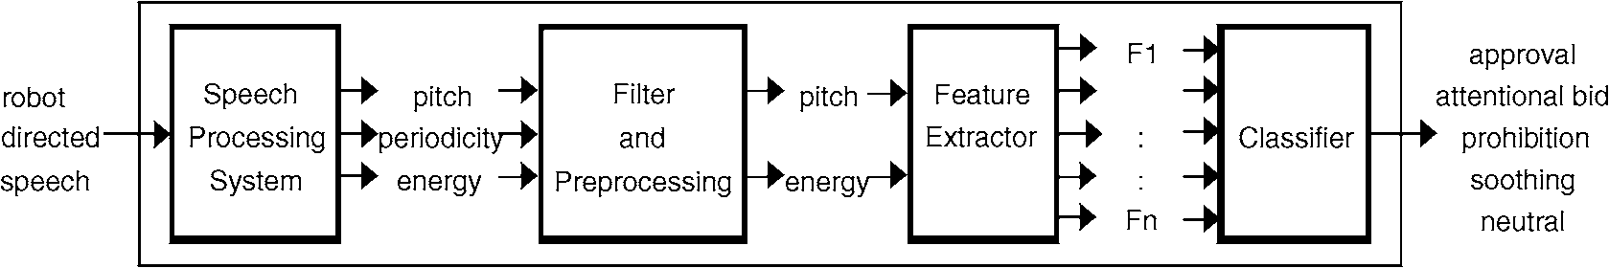
Algorithm : Classify emotional content in speech
Processing : tag sample with pitch, energy, percentage periodicity.
Filter out noise : very high pitches (non-uniform), very low pitches.
Calculate features (mean,variance of pitch,energy, pitch range )‏
Pass to classifier for result.

Slide 27
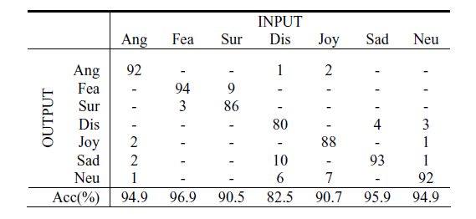
Results

Slide 28
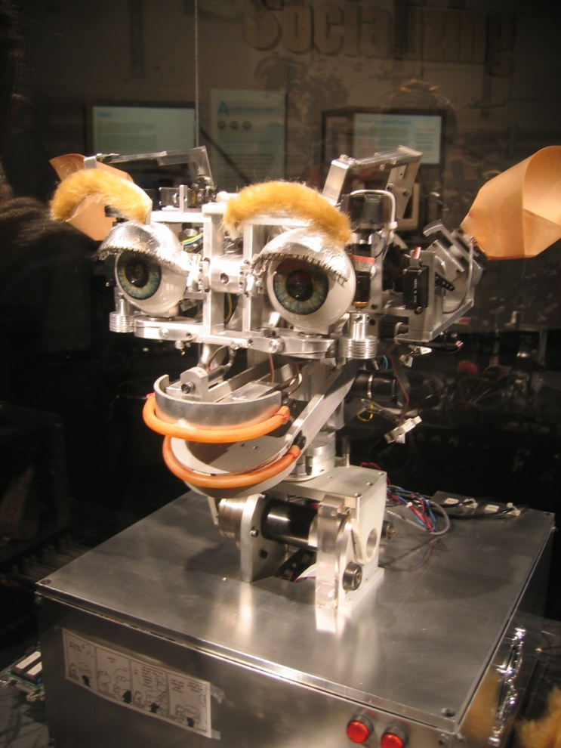
KISMET
Adaptive
Physical emotion display
Emotion lookup table
Realistic
Designed in the early 90s

Slide 29
[A,V,S] Emotion Model
[Arousal , Valence , Stance] :- A 3-tuple models an “emotion”.
Arousal:- Surprise at high arousal, fatigue at low arousal
Valence:- Content at high valence, Unhappiness at low valence
Stance:- Stern at closed stance, accepting at open stance

Slide 30
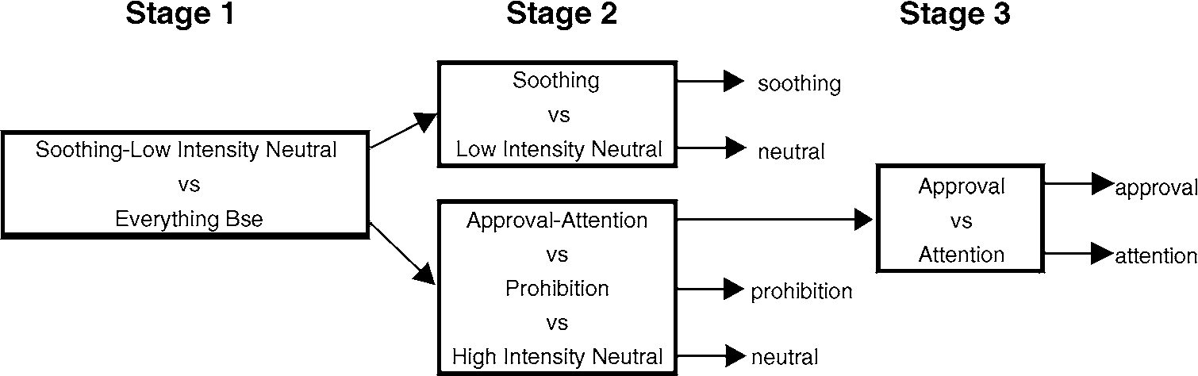
5-way classification in KISMET
Stage 1 : Energy parameters are used to differentiate. (soothing, low-intensity neutral have low mean energy).
Stage 2:
Using prosodic contours, soothing shows a smooth contour, frequency downsweep. Neutral is coarser and flatter.

Slide 31
Classification
Purely rule-based
approval and attention both show high mean pitch, high pitch and energy variance
prohibition has low mean pitch but high energy variation
neutral shows low energy and pitch variation.
Many rules really bulky and ad hoc
e.g. approval vs attention → both have high energy, and high pitch variation. But in approval, there is an exaggerated rise-fall pitch contour.

Slide 32
KISMET's response to emotion
Has a synthetic nervous system (SNS) to help react to external stimulus.
The 'somatic marker' process to tag incoming information with affective content.
Arousal : Level of emotional response
Valence : Is the stimulus+ve or -ve
Stance : How approachable is the percept?
This information is passed to the 'emotion elicitor'.
Emotional Elicitor : Each [A,V,S] input contributes to some emotion process. Eg, A large -ve valence might contribute to sad, anger, fear, distress emotions.

Slide 33
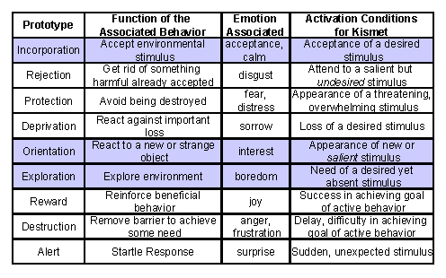
Kismet's Emotive Response Table

Slide 34
Response calculation
The winning emotion process affects the response if its value is above some threshold.
Two thresholds, one for behavioural response, the other for response through expression (the latter is lower). This indicates that expression leads behavioural response.
On praise, first comes interest, and then physical alignment.

Slide 35
Response desiderata
Aesthetics : Appearance should affect nature of human communication with it.
Real Time Perfomance : Long delays are not acceptable.
Voice : Humans should be able to use their natural voice for training. It should be able to recognize a vocalization as having affective content when the intent of the sentence is to approve/prohibit, etc.

Slide 36
Response desiderata
Unacceptable vs Acceptable misclassification: Shouldn't judge prohibition to be approval, but to judge it as neutral is an acceptable error.
Expressive Feedback : Respond to emotion to let the person know it has understood.
Speaker Dependence vs Independence: Former for personalized bots, latter for those that need to interact with many people.

Slide 37
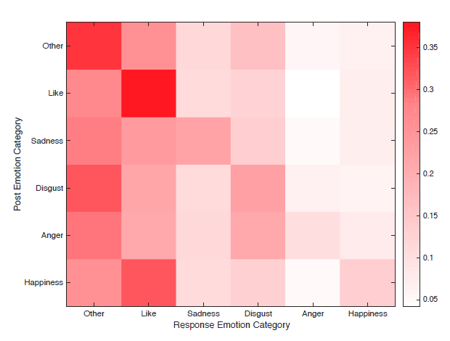
Response specifications
Empirical statement-response data from NLPCC 2014 dataset
23105 emotion annotated sentences from Weibo
(Zhou et al, 2017)

Slide 38
Detecting emotions from the body
Dealing with embodiment

Slide 39
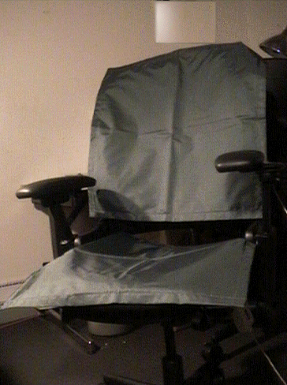


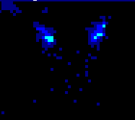
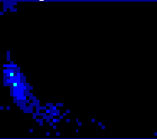
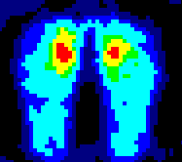
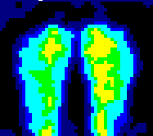
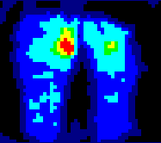
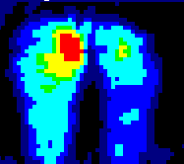
Can we teach a chair to recognize behaviors indicative of interest and boredom? (Mota and Picard)
Posterior inference (Mota & Picard, 2003)
Emotion detection using pressure sensors
Sit upright
Lean Forward
Slump Back
Side Lean

Slide 40
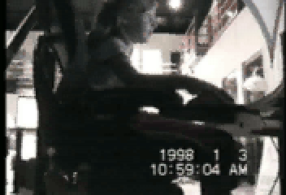
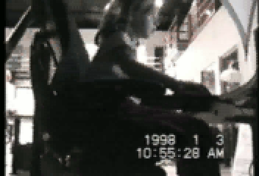
What can the sensor chair contribute toward inferring the student’s state: Bored vs. interested?
Results (on children not in training data, Mota and Picard, 2003):
9-state Posture Recognition: 89-97% accurate
High Interest, Low interest, Taking a Break: 69-83% accurate

Slide 41
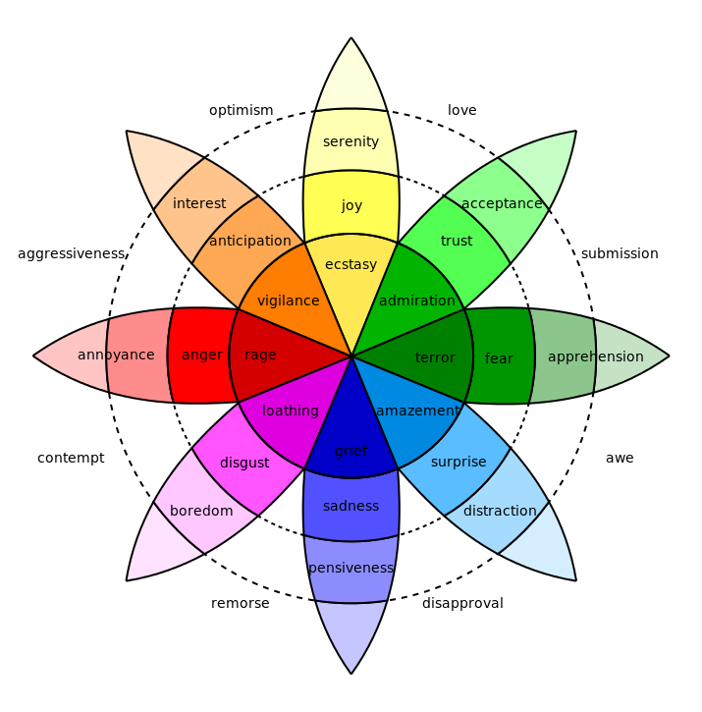
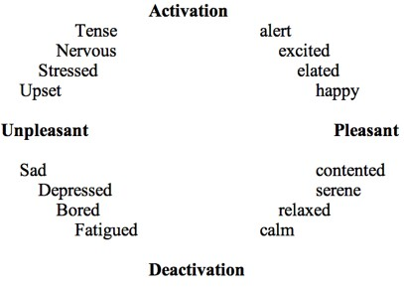
Models of emotion
Plutchik’s model

Slide 42
Theories of emotion
James-Lange → Stimulus causes physiological response, perception of bodily change is emotion
Cannon-Baird → Non-physiological independent basis of emotion
Schacter → Physiological response directs cognitive situational appraisal, ends up being confounded with emotional state

Slide 43
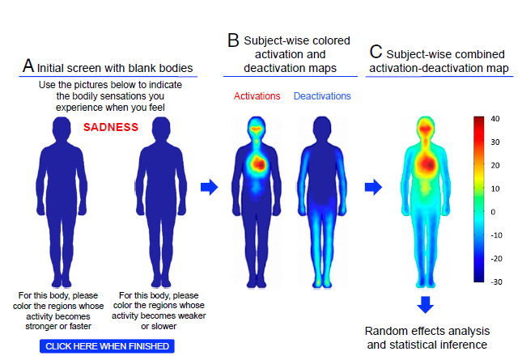
Are emotions situated in the body?
(Nummenmanaa et al, PNAS 2013)

Slide 44
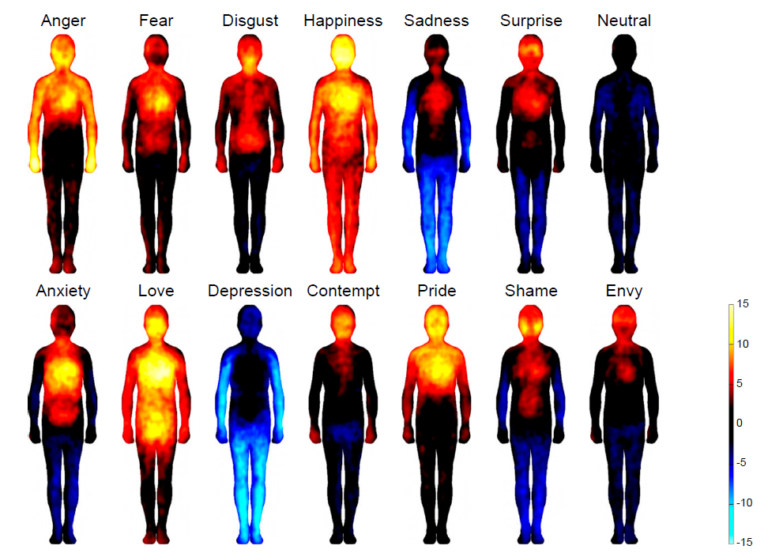
Bodily basis of emotions well-founded
(Nummenmanaa et al, PNAS 2013)
Patterns consistent across Finns and Taiwanese

Slide 45
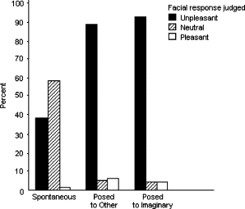
Emotions are heavily performative
8
In
Erickson and Schulkin, 2003
Percentage of facial responses to unpleasant odour classified as unpleasant, neutral, or pleasant in a spontaneous condition, a posed to real person condition, and a posed to imaginary audience condition

Slide 46
The problem
Facial and speech-based models can detect expressed emotion
Expressed emotion is heavily performative
Felt emotion is heavily embodied
How to
Measure felt emotion
Correlate with expressed emotion

Slide 47
Possible solutions
Psychological surveys
Physiological monitoring
Galvanic skin response
Blood volume pulse

Slide 48
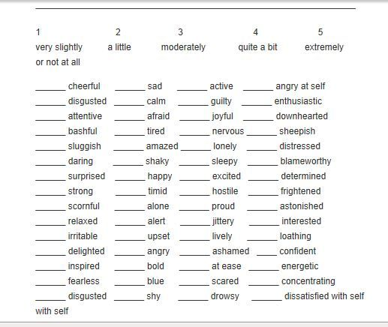
Surveys
Ask detailed questions
Ask same questions multiple ways
Use correlations to judge response authenticity
PANAS most common

Slide 49
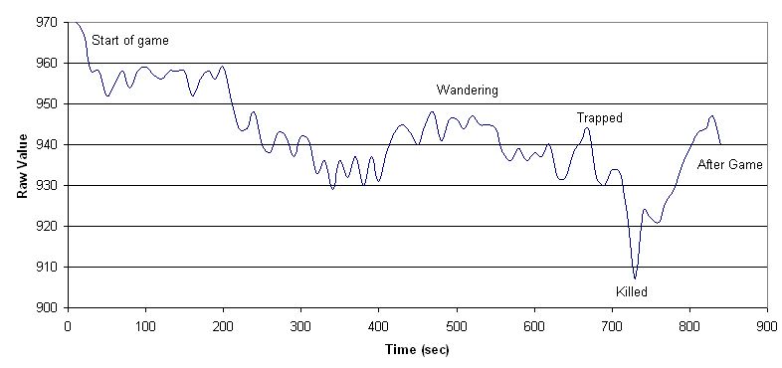
GSR
Ancient technique
Measures skin conductance
Function of sweat gland activity
Can measured generalized arousal

Slide 50


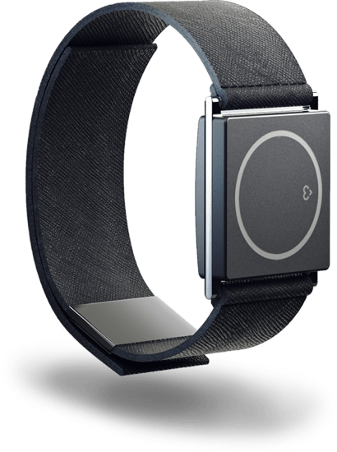
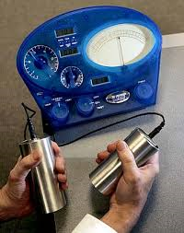
Existing uses
Picard Lab, MIT

Slide 51
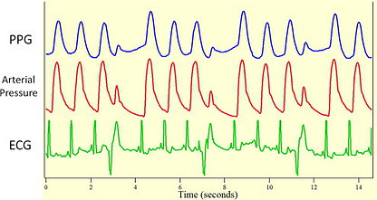
Photoplethysmography
Blood volume pulse = measure of how much blood is flowing through an organ
Measured using infra-red light reflection
Can measure easily at fingers, but also at other body sites
Similar uses as GSR

Slide 52
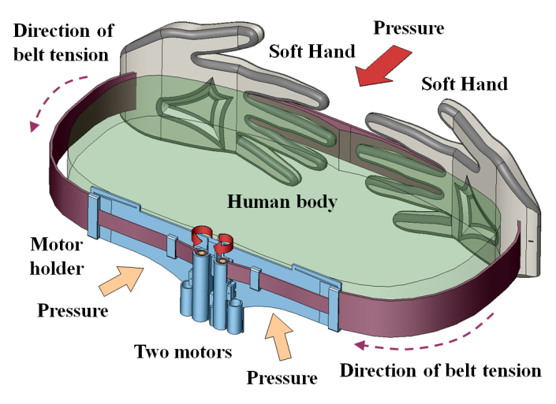
Possible applications
E-learning
Driver/pilot monitoring
Neuromarketing
Athletic performance monitoring
Quantified self applications
Digital co-presence
HaptiHug

Slide 53
Summary: emotion detection
Machine learning methods are hands off
Scale well, give good accuracy metrics
Not ecologically grounded
Biophysical methods are intrusive
Scale poorly, give good accuracy metrics but poor resolution of emotion space
Ecologically well-grounded
Surveys offer great resolution of emotion space
Scale terribly or not at all, very resource inefficient
Applications
Context-sensitivity in human-computer interaction
Monitoring human performance/engagement on tasks
Remote projection of affect

